Slide 1
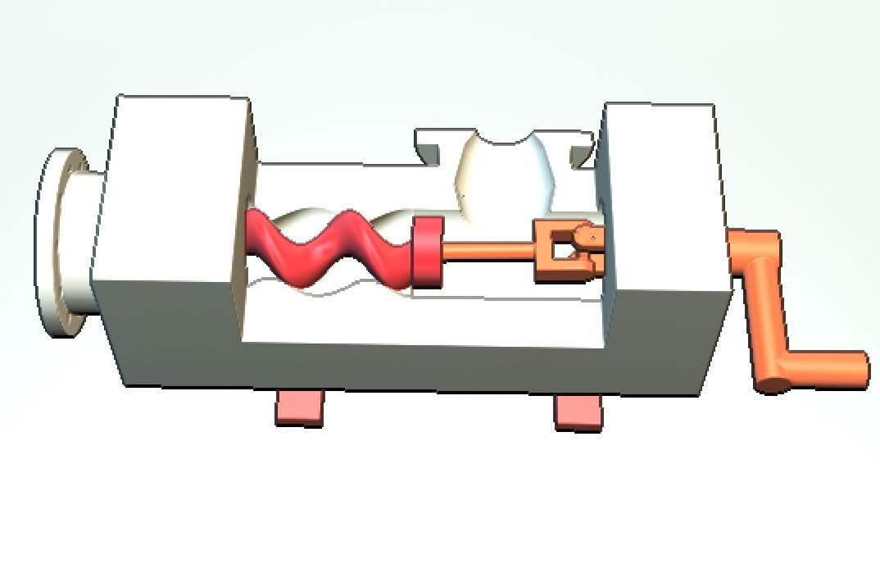
SINGLE SCREW PUMP
Pump Description
The pump consists of a cylindrical housing or stator which is double helical, and a helical rotor that fits inside the stator and rotates. The rotor has a helical shape that matches the thread of the stator, and as it rotates, it creates a series of cavities between the rotor and stator that move the fluid or material through the pump. For making this cavity, the rotor must have circular and translational motion. The Translational motion is achieved by a universal joint and for the rotational motion a driving shaft is installed. The fluid or material enters the pump through the inlet port and fills the space between the rotor and stator. The rotation of the rotor moves the cavities from the inlet port to the outlet port, carrying the fluid or material with them. As the cavities approach the outlet port, the pressure increases, and the fluid or material is discharged from the pump through the outlet port. The process is repeated, with the rotor continuing to rotate and create new cavities that move the fluid or material through the pump.
The 3D printed single screw pump with a universal joint mechanism exemplifies the remarkable capabilities of additive manufacturing in creating complex, functional, and customized components. This educational model serves as a testament to the ongoing advancements in manufacturing technology and its potential to reshape various sectors.
Parameters | Mathematical expression
Axial Displacement | D = P × N
Flow Rate | Q = π * N * (r1² - r2²) * L * ε / 1000
Relationship between Rotational Speed and Flow Rate | Q ∝ N

